Slide 1



Present at IEEE International Conference on Communications 2025
A Cascade Approach for APT Campaign Attribution in System Event Logs: Technique Hunting and Subgraph Matching
Yi-Ting Huang*, Ying-Ren Guo†, Guo-Wei Wong‡, Meng Chang Chen†
*National Taiwan University of Science and Technology
†Academia Sinica
‡National Taiwan University

Slide 2
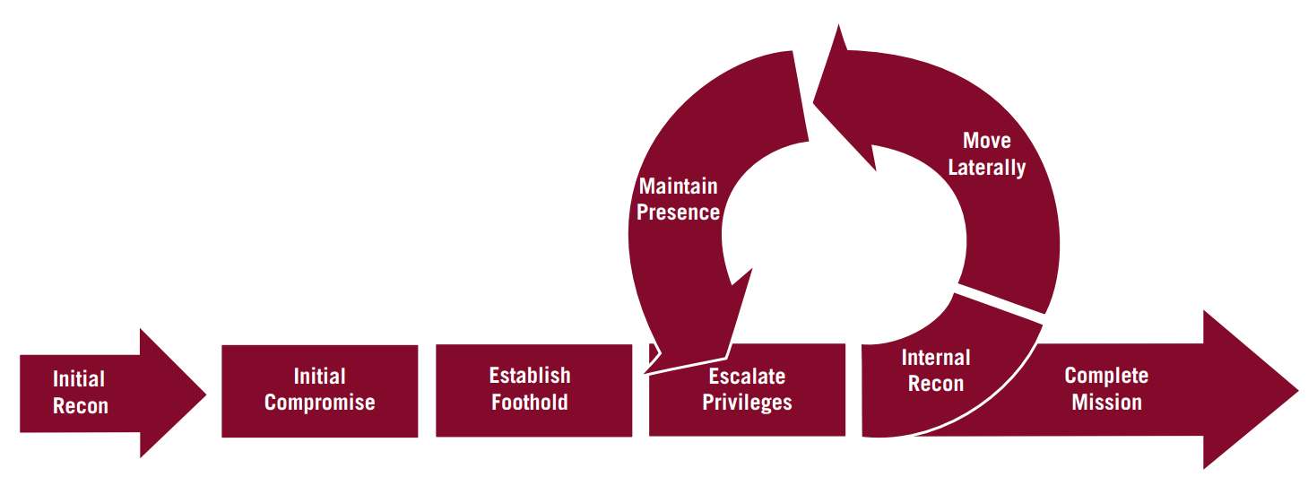
Background
Advanced Persistent Threats (APTs) has posed significant challenges to the cybersecurity community.
BlackEnergy
SolarWinds Compromise
Differ from traditional malware or botnet attacks, APT campaigns are multistage operations, that is often begin with gaining a foothold in a target environment, followed by prolonged periods of undetected activity, data exfiltration, and system compromise.
Mandiant's adversary life cycle

Slide 3
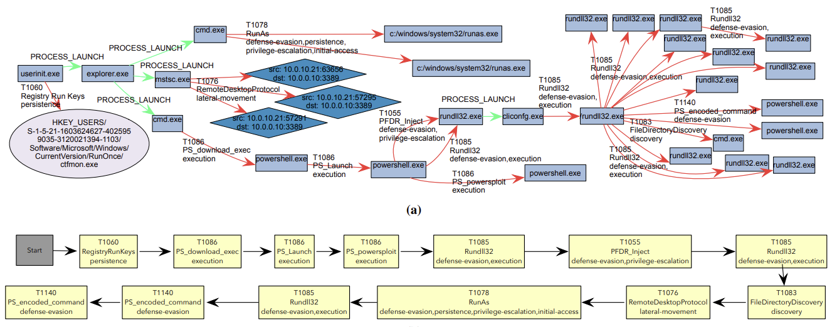
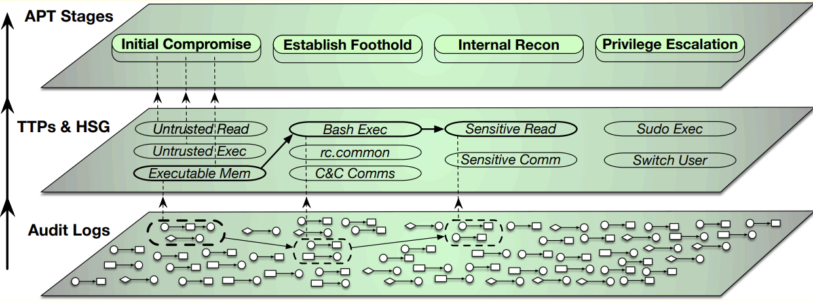
Motivation 1
Holmes [6] and MORSE [7] have shown that combining coarse-grained analysis (which classifies events as benign or malicious) with fine-grained analysis (which maps events to Tactics, Techniques, and Procedures, TTPs) can significantly enhance threat detection capabilities.
RapSheet [8] and KRYSTAL [9] focus on detecting known attack descriptors to construct contextual attack scenarios, further improving understanding of intrusion activity.
Holmes [S&P19]
RapSheet [S&P20]
Notes:
To address the persistent and multifaceted nature of Advanced Persistent Threats (APTs), systems like Holmes [6] and MORSE [7] have shown that combining coarse-grained analysis (which classifies events as benign or malicious) with fine grained analysis (which maps events to Tactics, Techniques, and Procedures, TTPs) can significantly enhance threat detection capabilities.

Slide 4
Motivation 1
Holmes and MORSE have shown that combining coarse-grained analysis (which classifies events as benign or malicious) with fine-grained analysis (which maps events to Tactics, Techniques, and Procedures, TTPs) can significantly enhance threat detection capabilities.
RepSheet and KRYSTAL focus on detecting known attack descriptors to construct contextual attack scenarios, further improving understanding of intrusion activity.
However, these methods typically require manual input to define mapping rules for recognizing attack patterns, which limits their scalability and automation potential.
Holmes [S&P19]
RepSheet [S&P20]
Notes:
To address the persistent and multifaceted nature of Advanced Persistent Threats (APTs), systems like Holmes [6] and MORSE [7] have shown that combining coarse-grained analysis (which classifies events as benign or malicious) with fine grained analysis (which maps events to Tactics, Techniques, and Procedures, TTPs) can significantly enhance threat detection capabilities.

Slide 5
Motivation 2
Forensic analysis of security incidents, whether to attribute attacks to specific threat actors or align them with known campaigns based on observable artifacts, remains a labor-intensive process.
Few studies have explored cyber threat attribution based on
observable attack stages [10]
attacker profiling [11]
artifact analysis [12]
Recognizing intrusion activities as part of known APT campaigns is equally important for improving system defenses and accelerating incident response.

Slide 6

Research purpose
We propose a machine learning-based Straight Forward Method (SFM) for audit log analysis and APT campaign detection.
Specifically, the tasks of this study are:
Malicious behavior identification: design a neural network detection model to discover malicious behaviors (MITRE ATT&CK TTPs)
APT campaign attribution: identify the most likely APT campaign by matching the discovered behaviors with known APT campaigns.
Notes:
Leverages neural networks to detect abnormal system activities and map them to MITRE ATT&CK techniques for enhanced interpretability.
APT campaign attribution: Matches detected behaviors against known APT campaigns based on observed techniques and attack patterns.

Slide 7
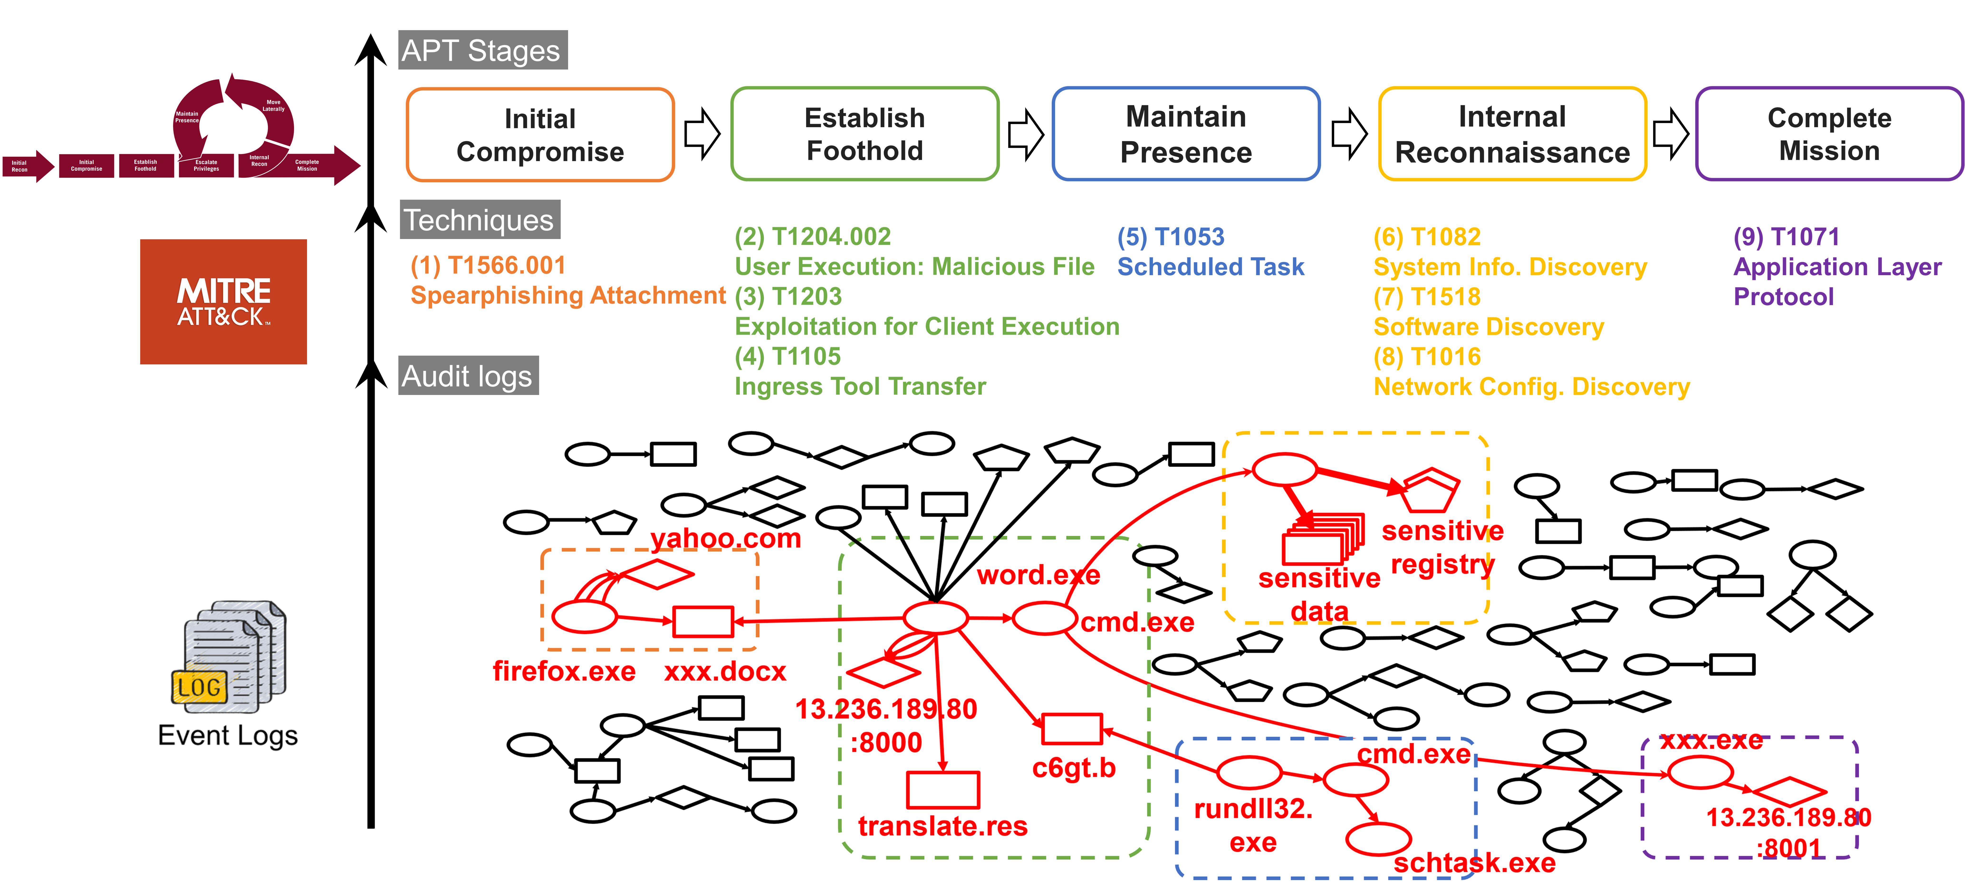
Our intuition
Notes:
Here is our intuition
When given a bunch of system event logs,
To deal with data imbalance, we firstly identify anomalous process.
And then these anomalous events are mapped to corresponding TTPs
aligning them with stages of the attack lifecycle.

Slide 8



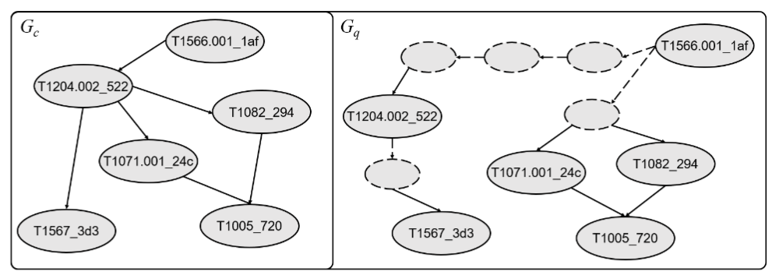
Our intuition
Campaign Graph
Query Graph
Notes:
Next, we construct a query graph from the discovered TTPs. Given a bunch of forensic incident reports, each campaign is represented as a campaign graph
composed of known attack techniques. By matching the query graph with campaign graphs, we can identify the most likely attacker.

Slide 9
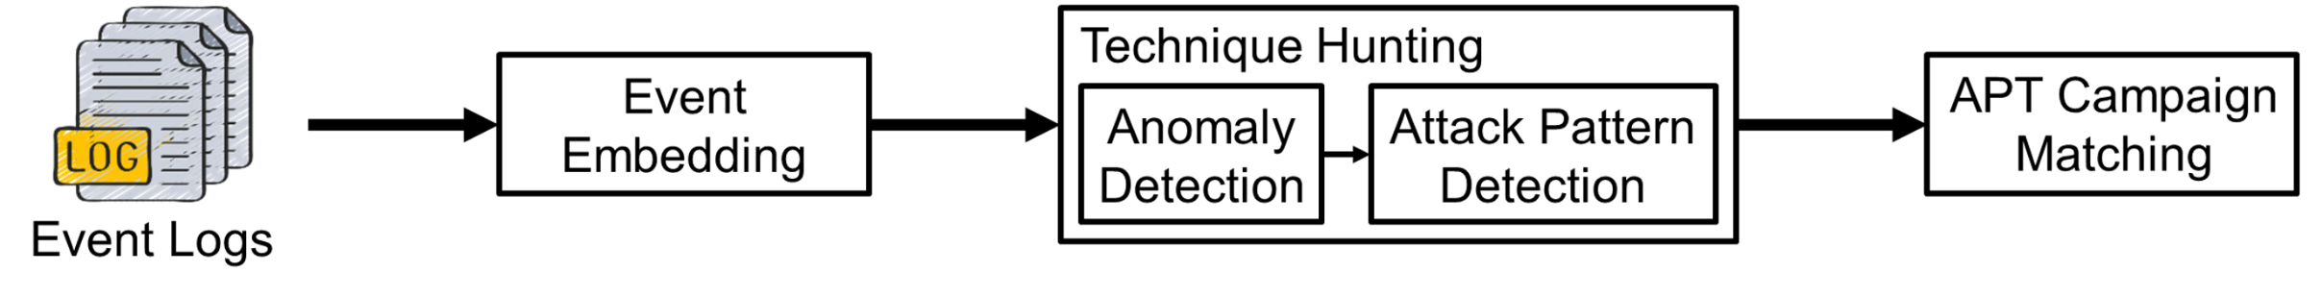
Straight Forward Method (SFM)
Event Embedding: Converts textual logs into numerical vectors.
Technique hunting:
Anomaly Detection: Handles event imbalance to highlight suspicious behavior.
Attack Pattern Detection: Uses sequence modeling to detect specific TTPs.
APT campaign matching: Matches to potential actors via graph-based similarity.
Notes:
Event Embedding: Converts textual logs into numerical vectors.
Technique Hunting: Identifies malicious techniques from event data.
Anomaly Detection: Handles event imbalance to highlight suspicious behavior.
Attack Pattern Detection: Uses sequence modeling to detect specific techniques.
APT Campaign Matching: Matches attack traces to potential actors via graph-based similarity.

Slide 10
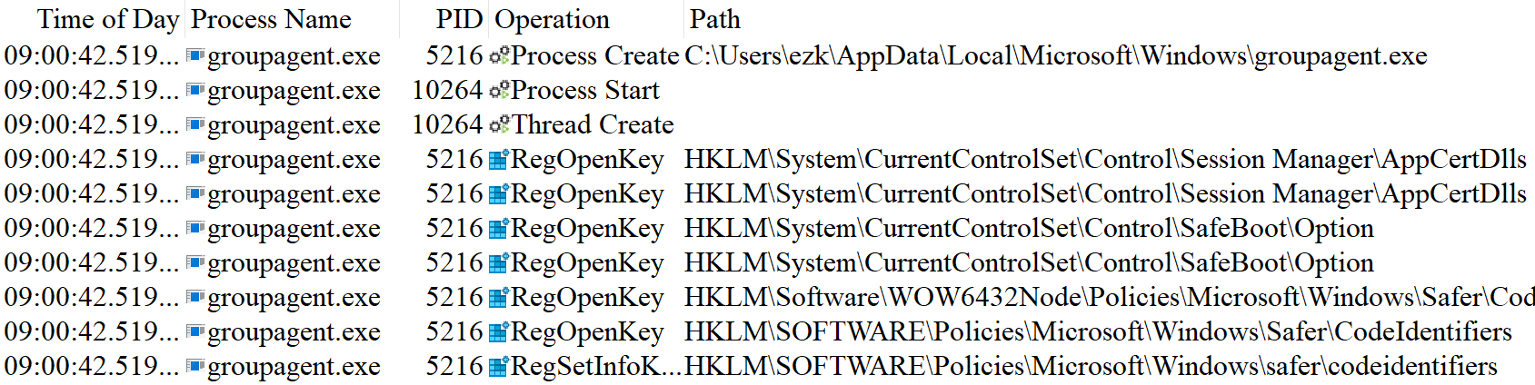
Event logs
Event logs are collected from the Process Monitor (ProcMon), which records detailed system activities such as process creation and registry access.
These logs provide critical information for analyzing system behavior.
Notes:
An event log is a system-generated record that documents activities related to system operations.
An entry in the audit log, called an event, contains detailed information such as timestamps, event sources, event types, process IDs, and other information that enables security analysts to capture and analyze system operations in real time.
groupagent.exe open Registry

Slide 11

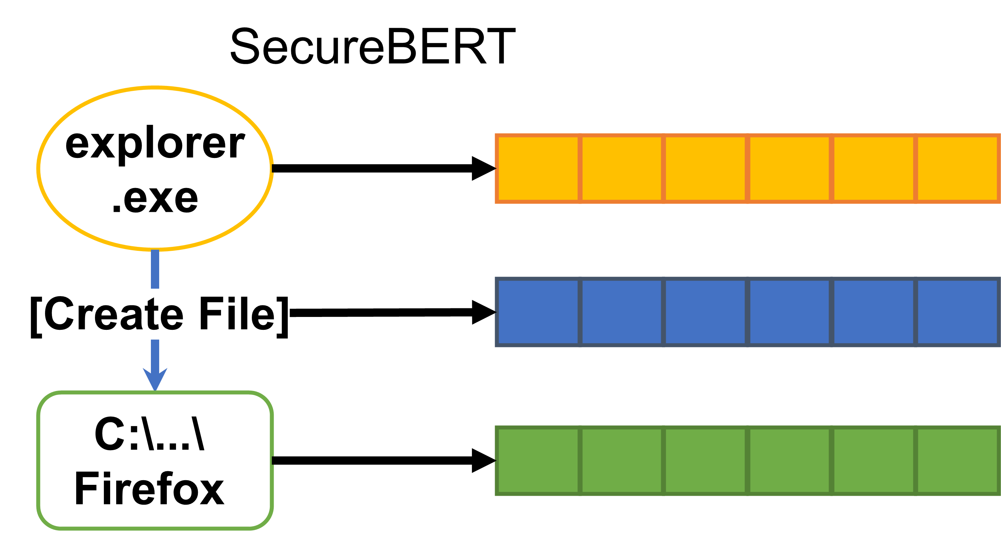
Event Embedding
To process system events, we use an embedding function, SecureBERT [14], to convert a single system event into numerical vectors.
SecureBERT is a domain-specific language model which is trained on a large amount of cybersecurity textual data.
Event embedding preserves meaningful semantics and contextual relations.
Notes:
To process these logs, we use an embedding function, SecureBERT, that converts the textual log data into numerical vectors that still preserve semantic relationships.
https://github.com/ehsanaghaei/SecureBERT

Slide 12
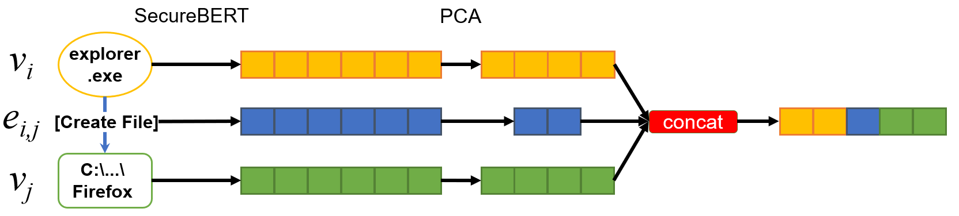
Event Embedding
Since the SecureBERT embeddings are high-dimensional (768), we further apply principal component analysis (PCA) to reduce dimensionality.
The resulting embeddings serve as features of individual events for subsequent tasks, i.e. anomaly detection and attack pattern detection.
768
256
16
256

Slide 13
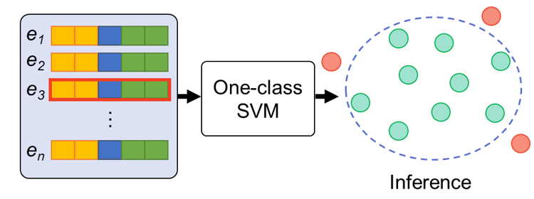
Anomaly Detection
In real-world scenarios, there is often a significant imbalance between attack and benign events.
E.g. in the DARPA TC3 dataset, compared to over 14 million benign events is collected in one day, attack events number only around 5,300 (2600:1).
To mitigate this, we use a one-class support vector machine (SVM) to preserve likely malicious processes.

Slide 14
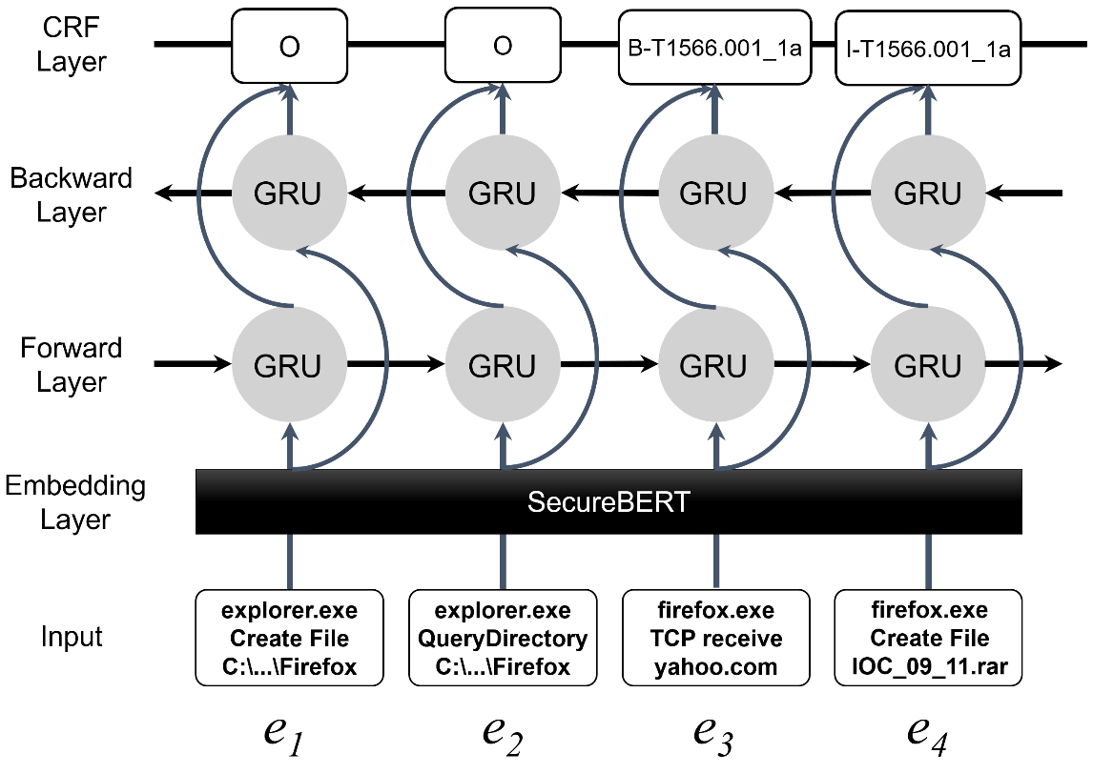
Attack Pattern Detection
Since a Technique may involve in more than one events, BiGRU-CRF is employed to identify TTPs within the malicious events.
Bidirectional Gated Recurrent Units (BiGRU): to process the sequence in both directions.
Conditional Random Field (CRF): to jointly decode labels across sequences by capturing dependencies among neighboring labels.
Notes:
Following anomaly detection, the likely malicious events proceed to attack pattern recognition.

Slide 15
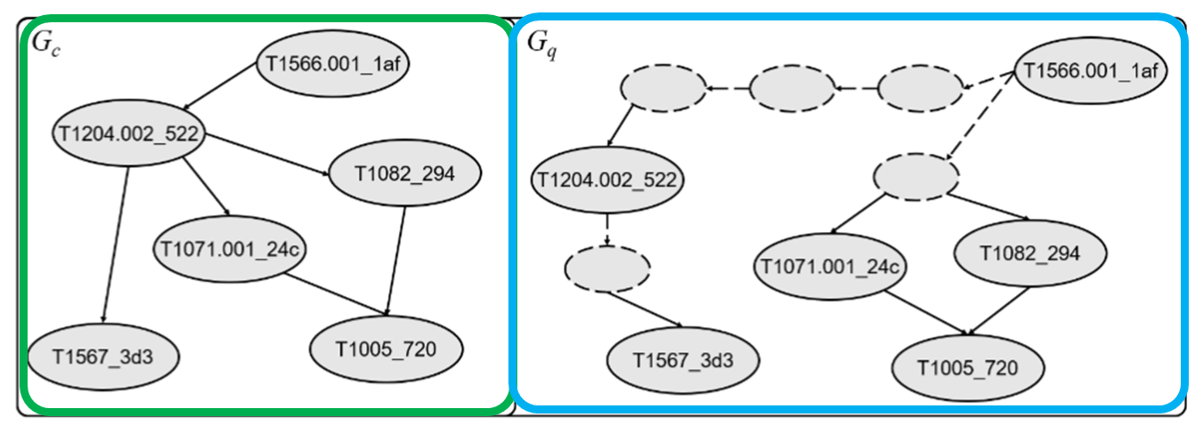
APT Campaign Matching
Determining the most likely APT campaign is formulated as graph-matching problem.
Subgraph isomorphism problem is NP-complete.
We observe that nodes within Gq often do not align consistently with nodes in the known campaign Gc due to high FP and FN rates.
Gc: campaign graphs from CTI reports
Gq: discovered TTPs graph from event logs
Node: TTPs
Edge: a temporal relationship between two TTPs involving the same system entities.

Slide 16
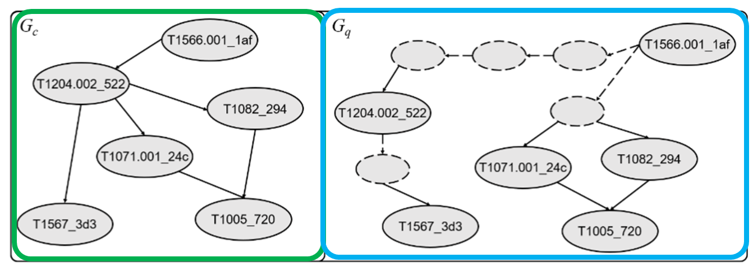
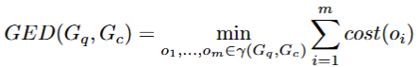
APT Campaign Matching
Graph Edit Distance (GED):
A measure of similarity between two graphs based on the minimum cost needed to transform one graph into another.
Insertion (e.g., adding a new technique),
Deletion (e.g., removing an unmatched technique), and
Substitution (e.g., replacing one technique with another).
The lower the total cost of these operations, the more similar the graphs are.
The threat actor whose campaign graph has the smallest GED to the query graph is considered the most likely match.
costs associated with operation
deletion
substitution
insertion
Notes:
To identify the most likely threat actor, we use Graph Edit Distance (GED)—a measure of similarity between two graphs based on the minimum cost needed to transform one graph into another.
This transformation involves a series of operations:
Insertion (e.g., adding a new technique),
Deletion (e.g., removing an unmatched event), and
Substitution (e.g., replacing one technique with another).
The lower the total cost of these operations, the more similar the graphs are.
Thus, the threat actor whose campaign graph has the smallest GED to the query graph is considered the most likely match.

Slide 17
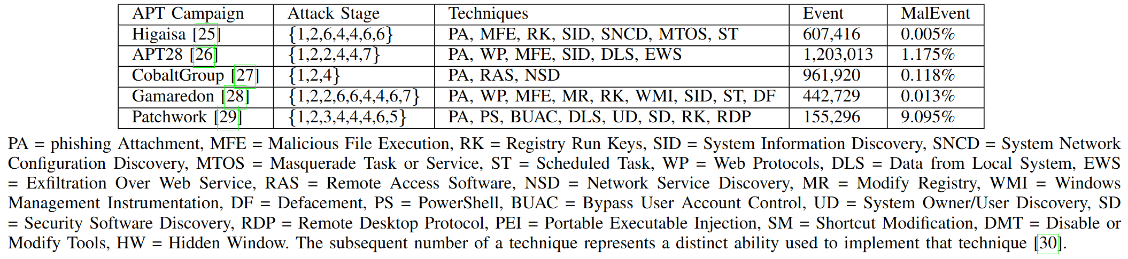

Evaluation Settings
Dataset:
Five synthetic campaigns from SAGA [30][31]
21 Technique labeling
Baseline: Sigma
open and widely used signature format as fine-grained attack patterns

Slide 18
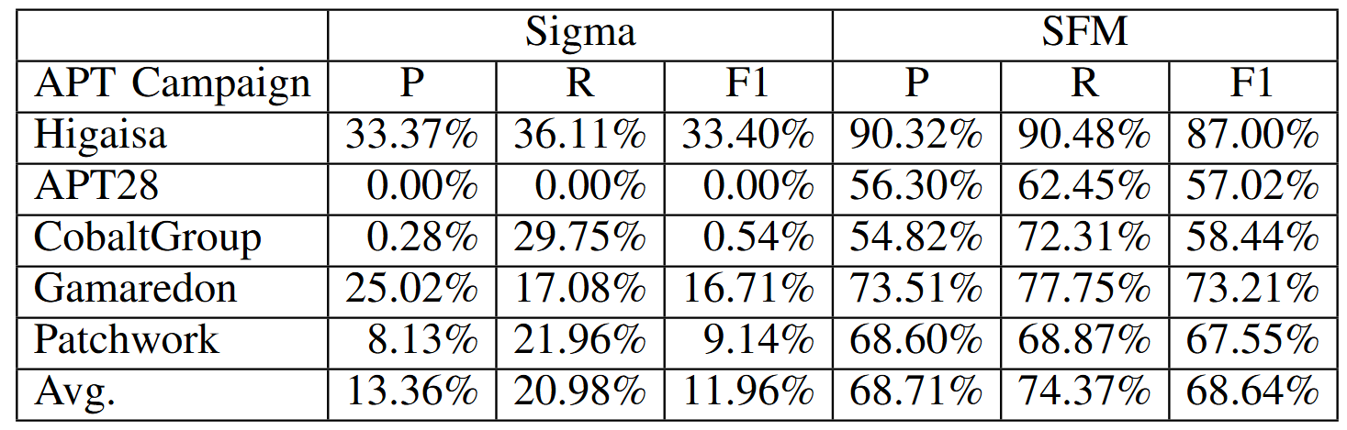
Evaluation on TTPs detection
Our methodology exhibits substantial performance compared to Sigma.
Sigma rules, while designed by experts, only cover portions of attack behaviors, leaving numerous malicious activities undetected
Notes:
We compared SFM with Sigma using five synthetic APT campaign datasets. While Sigma provides a widely used rule-based baseline aligned with MITRE ATT&CK. The results highlight SFM’s effectiveness in detecting fine-grained attack patterns beyond the scope of traditional signature-based methods.

Slide 19
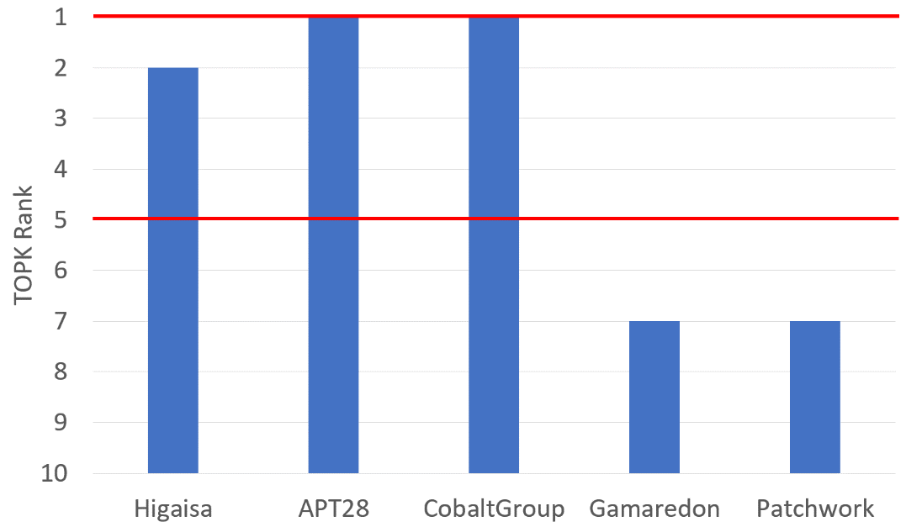
Evaluation on APT campaign attribution performance
Top-1 ranking: 40% correctly matched.
Top-5 ranking: 60% correctly matched.
Implication:
GED tolerates minor detection errors
It narrow down the pool of likely threat actors, even in real-world scenarios.
Notes:
When evaluating our attribution performance, we observe that
the correct threat actor appears at the top rank in 40% of cases.
If we extend our evaluation to the top 5 ranks,
the correct actor is included in 60% of cases.
This demonstrates the system’s ability to significantly narrow down the pool of likely threat actors, even in complex real-world scenarios.

Slide 20
Conclusion
This study presents a machine learning-based SFM for identifying potential APT threat actors.
Results show SFM
detects over 60% of techniques successfully from system event logs
attributes APT campaigns to the correct threat group within the top 5 ranks in 60% of cases.
These highlight SFM as a promising approach for APT detection and attribution, helping to narrow down likely threat actors in real-world scenarios.
Notes:
SFM detects over 60% of techniques from system event logs and attributes APT campaigns to the correct threat group within the top 5 ranks in 60% of cases. These results highlight SFM as a promising approach for APT detection and attribution, helping to narrow down likely threat actors in real-world scenarios.

